Slide 1

Understanding the Ecosystem:
Cyber security policy challenges
Madeline Carr, UCL STEaPP & RISCS
Notes:
Why focus on this? Policy making is increasingly difficult and there is not much research to support or inform it.
Understanding the ecosystem of public sector cyber security is both challenging and important. This presentation highlights some recent research into the links between the technical dimensions of cyber security and incident response and domestic / international policy.

Slide 2

Cyber as a ‘wicked’ problem
Spills across policy portfolios
Different (sometimes conflicting) goals
UK and international approaches.
Notes:
Can mean quite different things: data protection, network security, national security, consumer rights, human rights and law enforcement.

Slide 3

Recent research
Evaluating Cyber Security Evidence for Policy Advice
Cyber Metrics – Getting the Conversation Straight
International Dimension – Global Policy Coordination

Slide 4

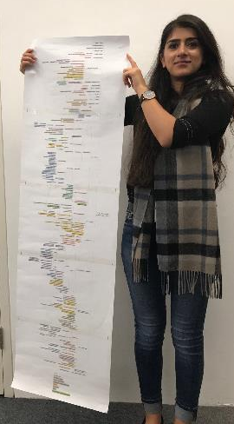
Mapping the
landscape

Slide 5

ECSEPA
(Evaluating Cyber Security Evidence for Policy Advice
Demands a level of technical expertise
Relatively disparate group of people
Impact shapes national and international landscape

Slide 6

Cyber Metrics
Getting the conversation straight
What do the producers of metrics think is important?
What do the consumers of metrics think is important?
How and why do they differ?
Notes:
If cyber metrics are to be helpful, they have to make sense.

Slide 7

International Dimension
Global Cyber Policy Coordination
Current challenges
Emerging problems and…
How to tackle them

Slide 8
This MPA degree prepares future leaders and decision makers working in policy to meet the challenges and opportunities
presented by today's fast-evolving digital technologies.

Slide 9

Thank you
Madeline Carr, UCL STEaPP & RISCS

