Slide 1


Protecting the Next
Generation from Cyber Attacks
Michael Eva, London Grid for Learning

Slide 2

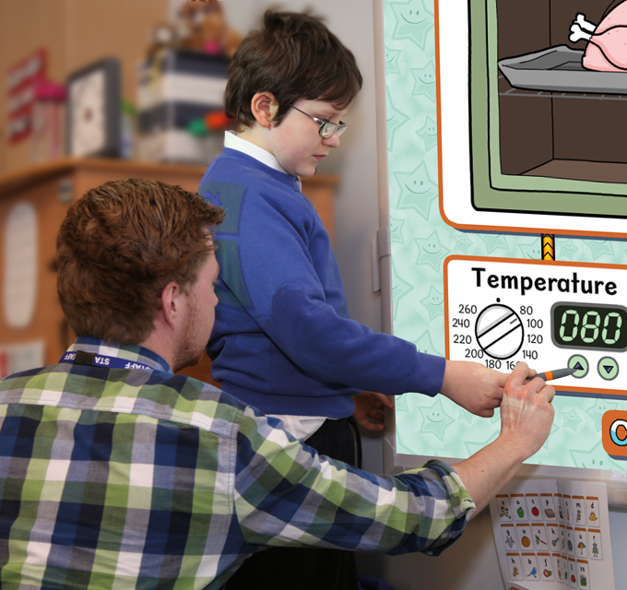
Our Charitable Aims
Save Schools Money
Keep Children Safe
Energise Teaching & Learning
Tackle Inequality
Enhance Wellbeing
AND NOT FOR PROFIT

Slide 3
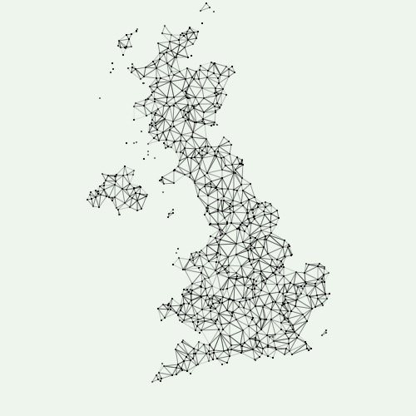
National
Coverage
In over
70 Local
Authorities
We now provide services to nearly 3,500 sites
across the UK

Slide 4


Slide 5
Super Value Subscription
Fast-growing, cross-sector charity
Cost-neutral to schools
Centres of excellence

Slide 6

#SuperCharge

Slide 7

#SmartBuy
Power of Our Community
Cheaper for
Suppliers
All savings
reinvested

Slide 8




@LGfLDigiSafe
Schoolsafe, best-of-breed technology including filtering (and soon monitoring), email & data encryption
Training, advice and guidance
One-stop resource portal
CyberPass online-safety diagnostic tool
Template policies and agreements
National profile and policy and practice shaper e.g. UKCCIS

Slide 9
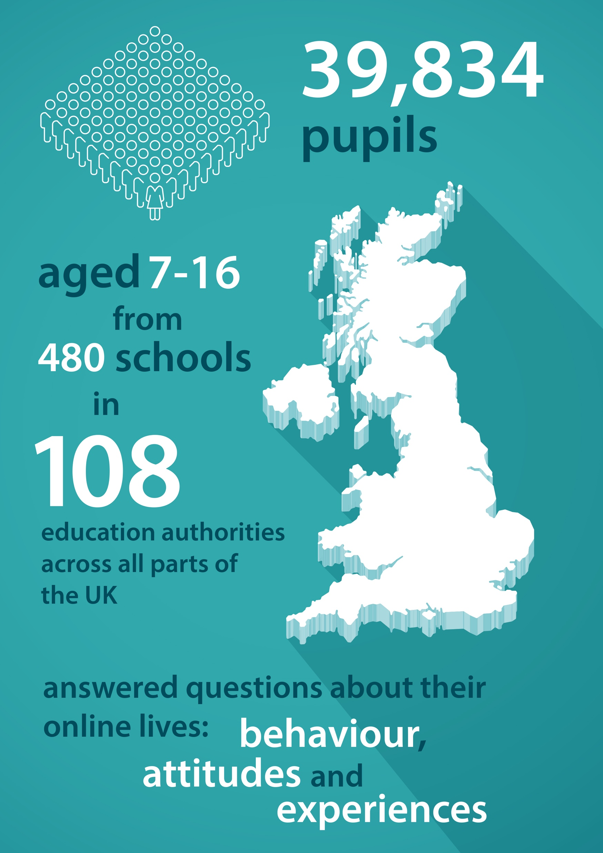


Pupil Online Safety Survey

Slide 10

#Energise
Innovation, Skills & Transformation

Slide 11
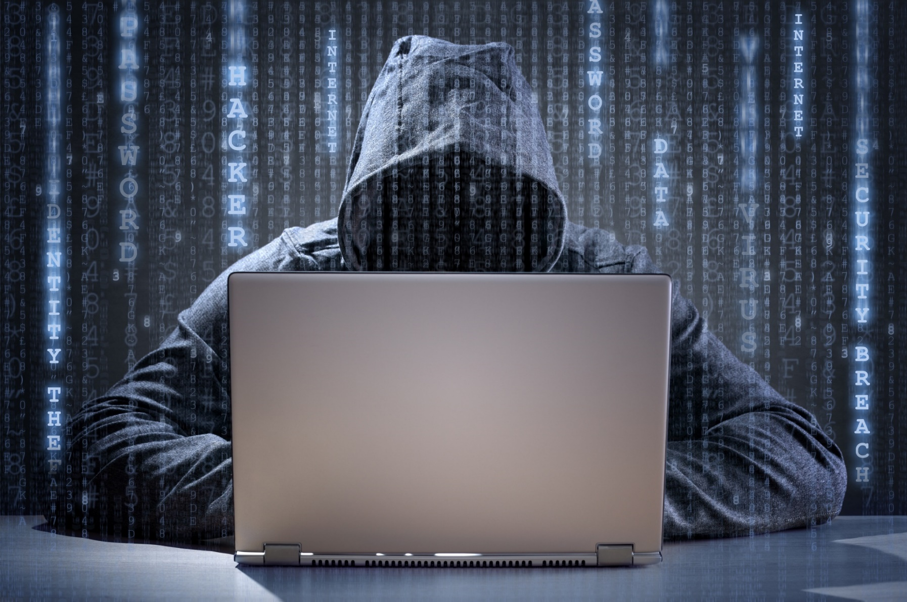
#CyberProtect

Slide 12
Cyber Threats and Hazards
Massive DDoS Attacks
  Outsider and Insider Threat
Malware
  Viruses
  Ransomware
Types of Phishing
  Classic Phishing
  Spear Phishing
  Whaling
Malicious Hacking

Slide 13
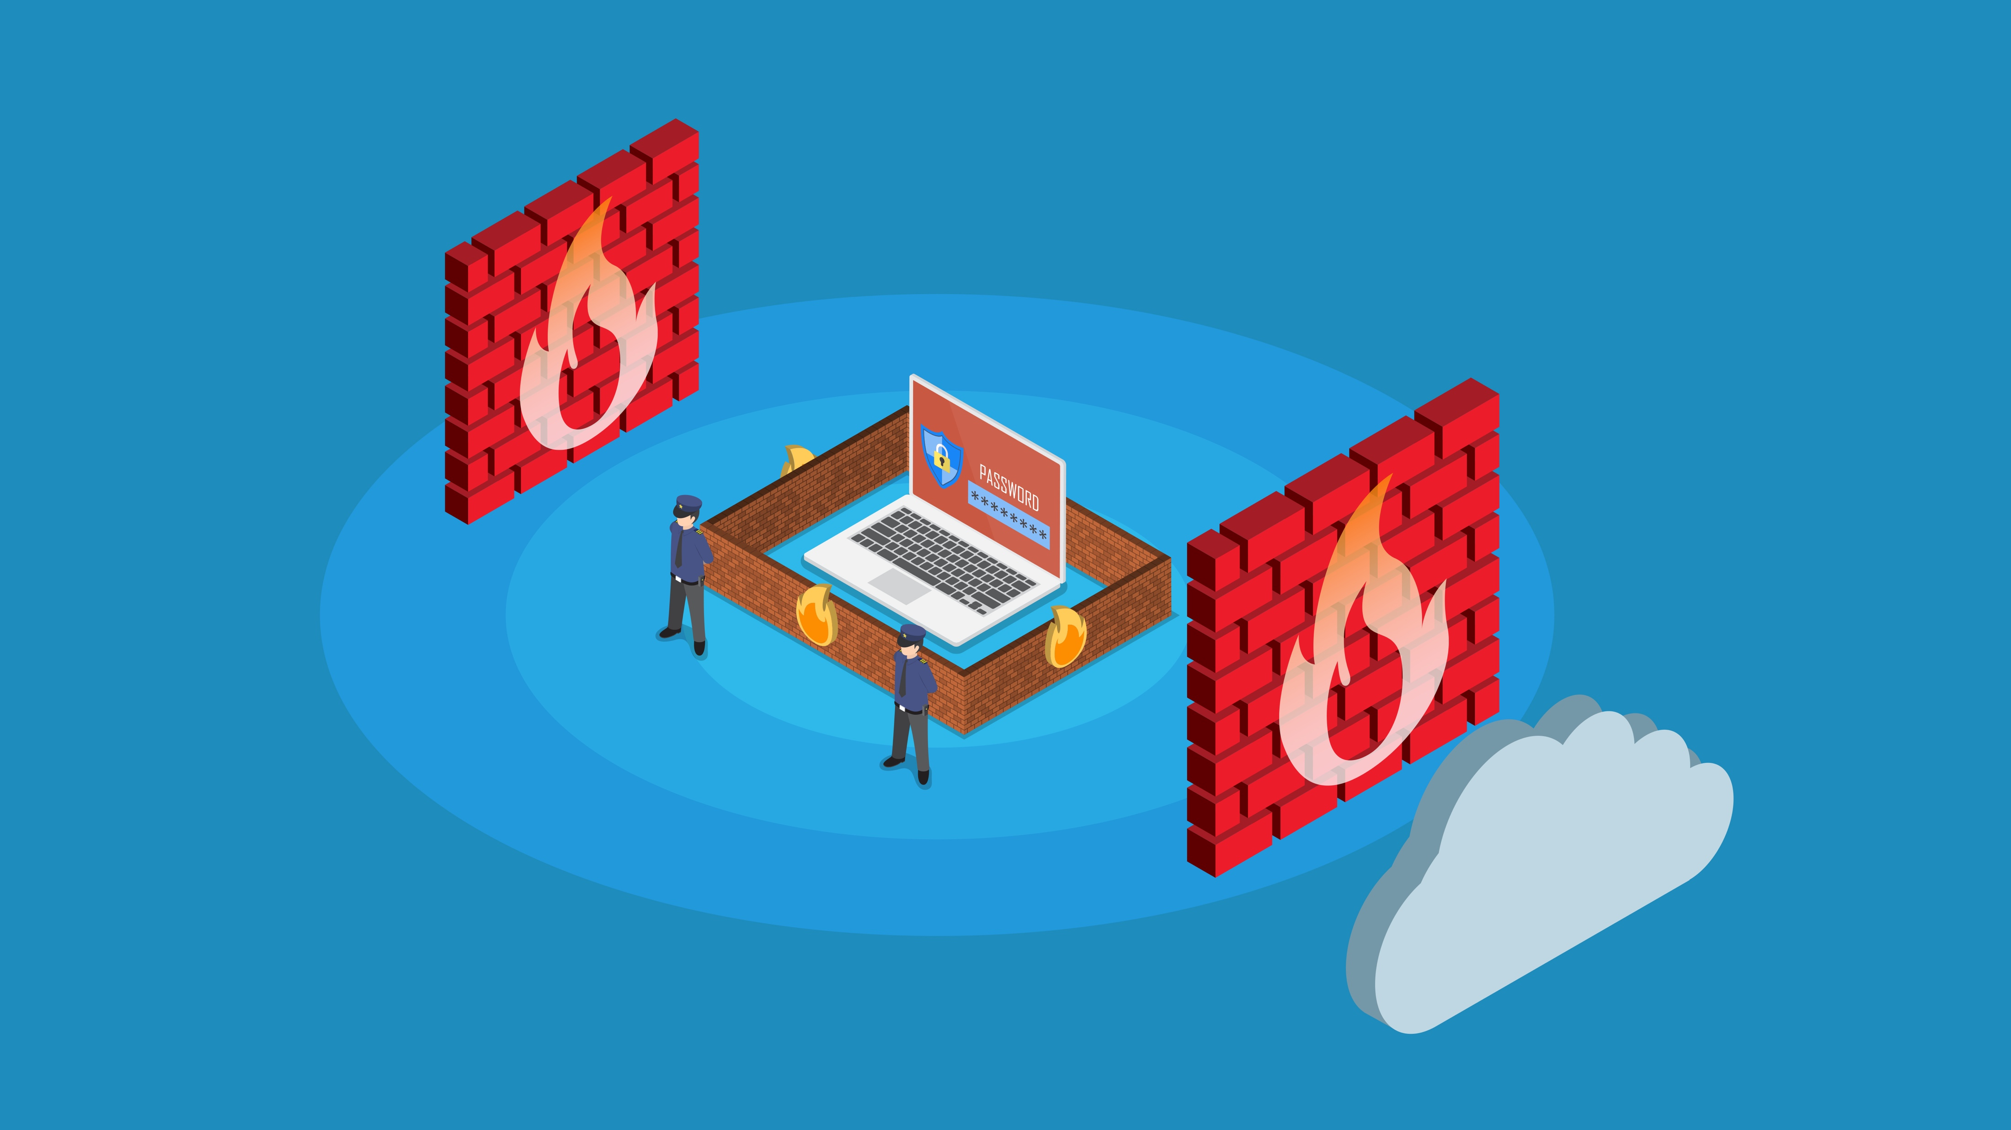
CyberProtect Stages of Defence
4. Local Firewalls at Schools to Help Defend Schools Against Each Other
5. Endpoint Protection:
3. Cloud Security Services:
a. Anti-Virus
b. MalwareBytes
c. Patch Management
a. Egress – Secure Email
b. MERAKI – Mobile Device Management
c. Intercept X – Anti-Ransomware
d. MailProtect – Email Filtering
e. Server Advance - Protecting Servers from Ransomware
f. WebScreen – Web Filtering
g. WSUS – Patch Management
7. End Users – Anti Phish for User Education
6. Security Operations Centre – Alerting and Monitoring Protecting the Network
2. Core Firewalls Protecting Network
1. JANET – Protection from DDoS

Slide 14

Defence in Depth
DDoS Protection
Sophos Suite
  Intercept X – 350,000 endpoints
  Server Advance
  Anti-Phish
Malwarebytes – 200,000 endpoints
WebScreen – 1 billion URLs filtered every day
MailProtect – 1 million emails scanned every day
Meraki – 200,00 endpoints
Egress
Globally significant implementations

Slide 15

The Cloud & Transformation Challenge
Adoption
Absorption

Slide 16

@LGfL @ LondonGridforLearning

